Slide 1

EEG Signal Classification using transfer learning
Mohammad Mahdi Mirrashid
Dr. Shamsollahi
mohammadmahdi.mirrashid@ee.sharif.edu
EE Department – Sharif University of Technology

Slide 2
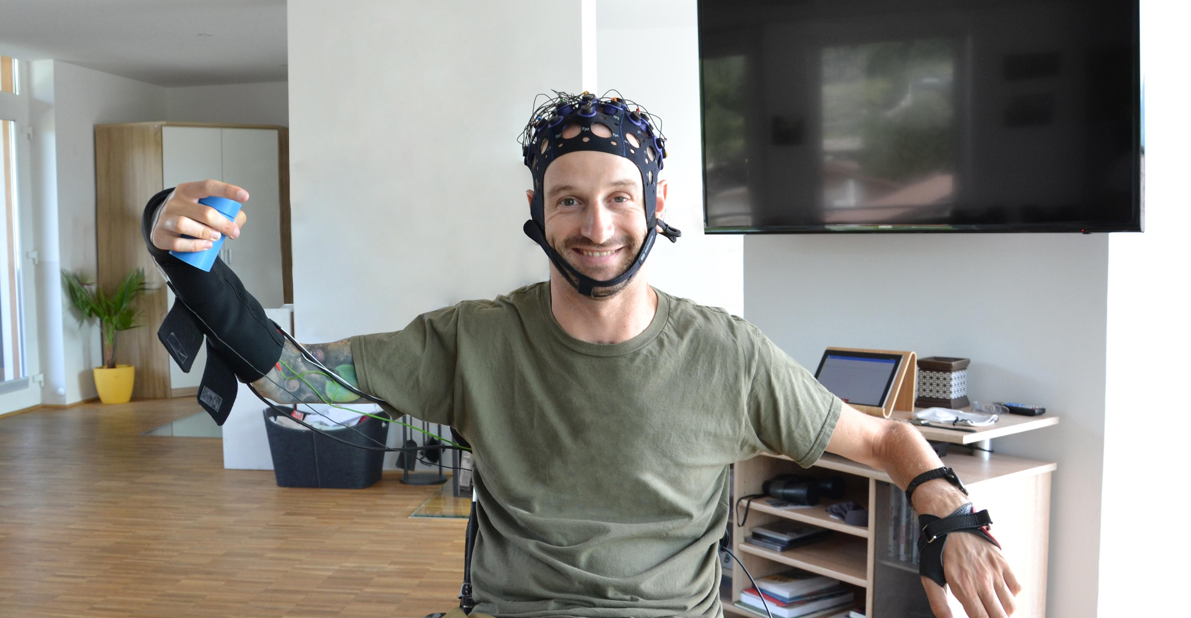
INtroduction

Slide 3
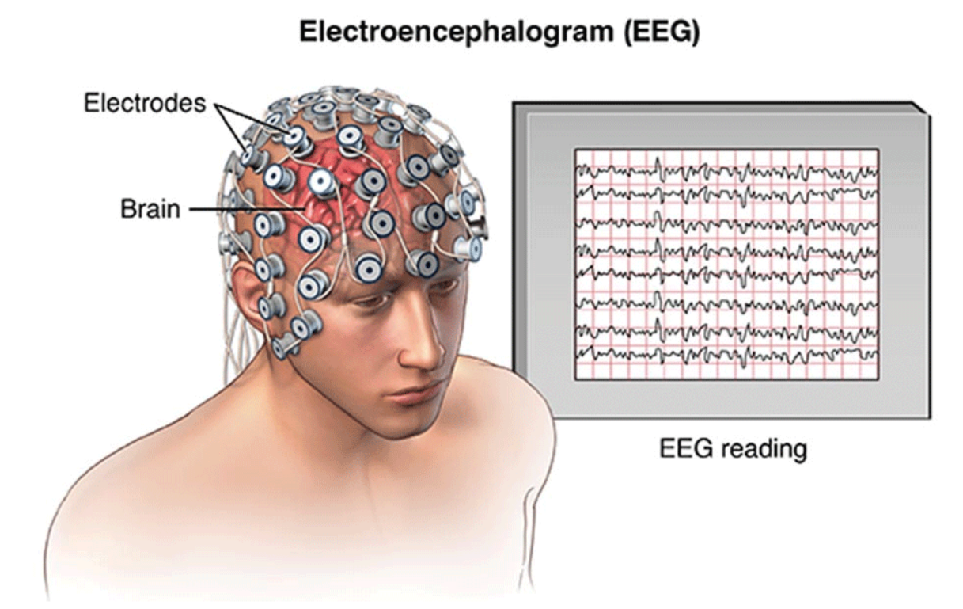
Introduction: EEG
EEG signal (Electroencephalography)
Applications
Rehabilitation
Emotion recognition
Research
Challenges
Cross subject/session variance
Noise

Slide 4
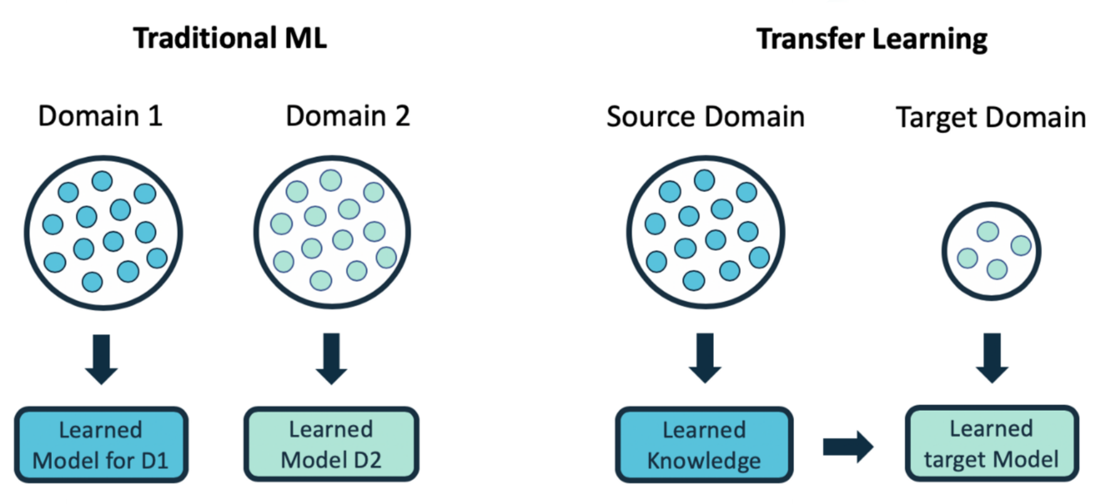
Introduction: transfer learning definition
Problem definition (domain and task)
Knowledge transfer (source to target)

Slide 5
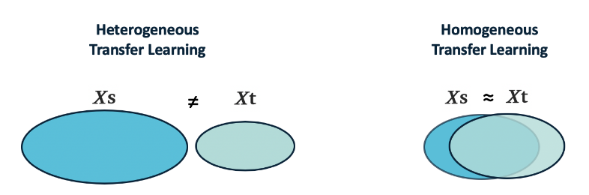
Introduction: transfer learning applications and settings
Advantages
Works with limited or no labeled target data
Efficiency through model reuse
Applicable to complex models with challenging computations and limited data (image recognition, NLP, speech recognition etc.)
Settings
Homogeneous/Heterogeneous transfer learning

Slide 6
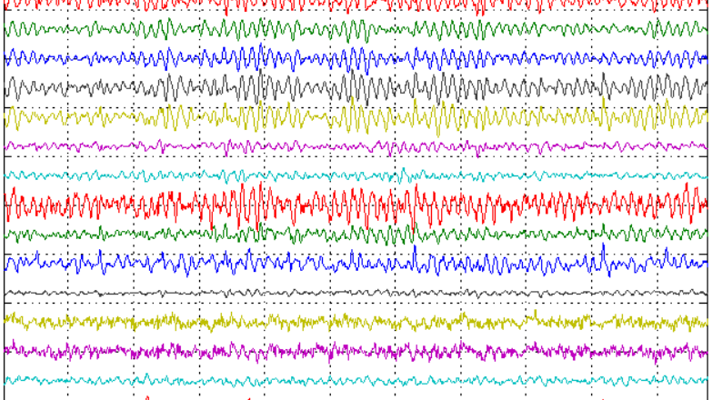
eeg signal classification using transfer learning

Slide 7
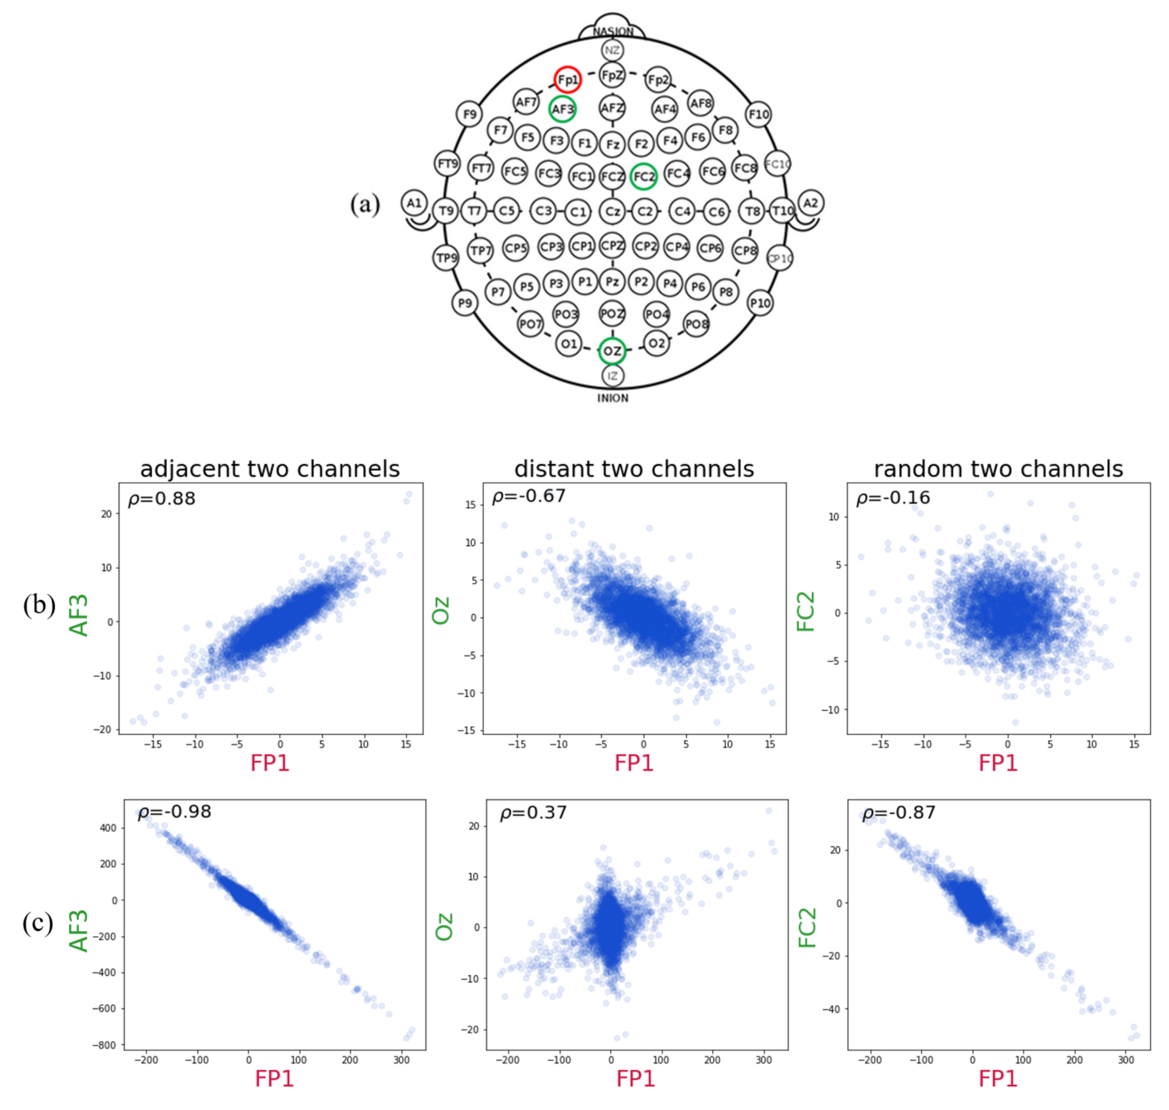
Eeg signal classification: the transfer learning approach
EEG signal variation (domain)
Lack of sufficient labeled data
Different subjects/sessions
Different devices

Slide 8
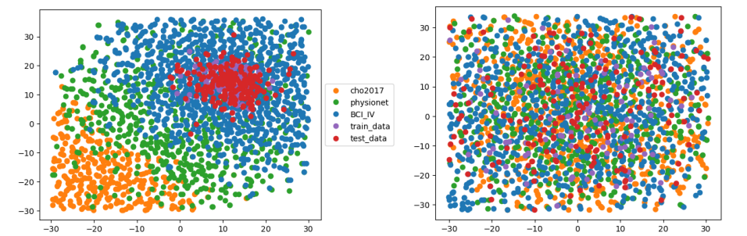
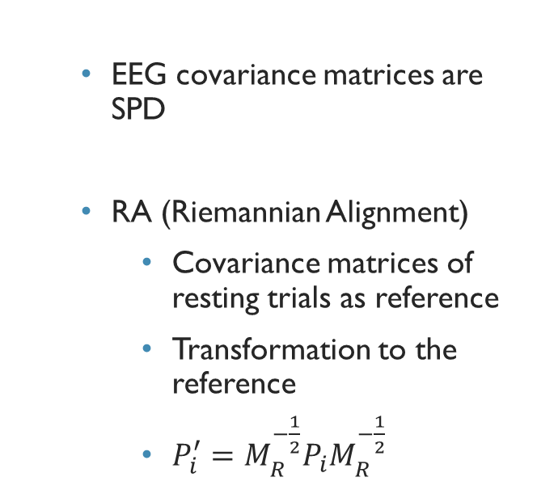
Eeg signal classification: Data alignment 1
EEG covariance matrices are SPD
RA (Riemannian Alignment)
Covariance matrices of resting trials as reference
Transformation to the reference
$P_{i}^{′}=M_{R}^{−\frac{1}{2}}P_{i}M_{R}^{−\frac{1}{2}}$

Slide 9
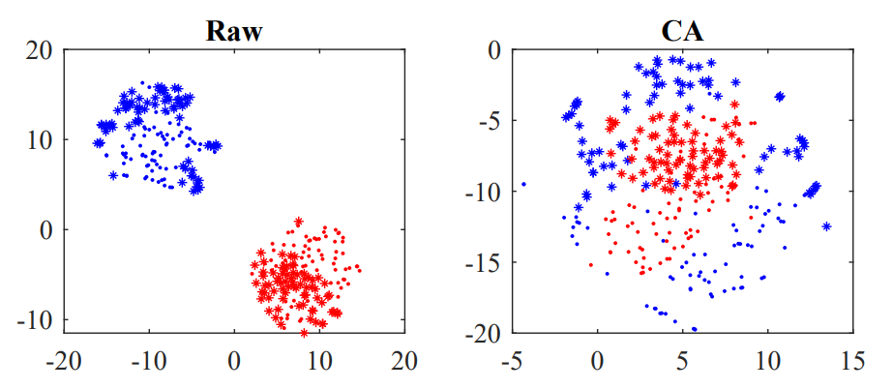
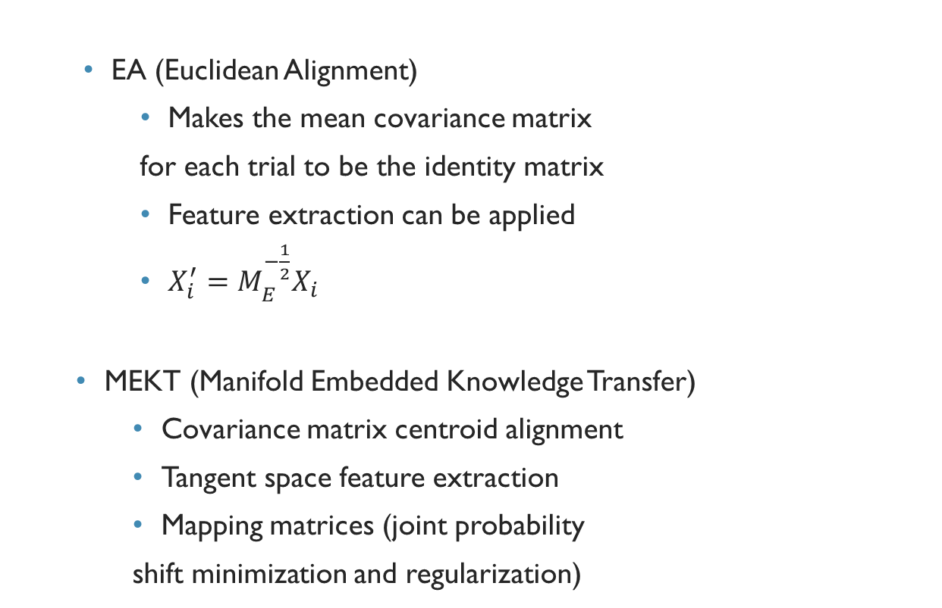
Eeg signal classification: Data alignment 2
EA (Euclidean Alignment)
Makes the mean covariance matrix
for each trial to be the identity matrix
Feature extraction can be applied
$X_{i}^{′}=M_{E}^{−\frac{1}{2}}X_{i}$
MEKT (Manifold Embedded Knowledge Transfer)
Covariance matrix centroid alignment
Tangent space feature extraction
Mapping matrices (joint probability
shift minimization and regularization)

Slide 10
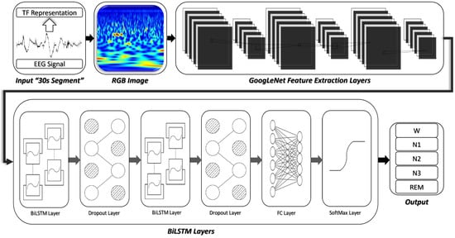
Eeg signal classification: deep Learning, machine vision
CNN with three layers: feature extraction, feature reduction, dense layer trained on calibration data
GoogleNet
BiLSTM layer

Slide 11
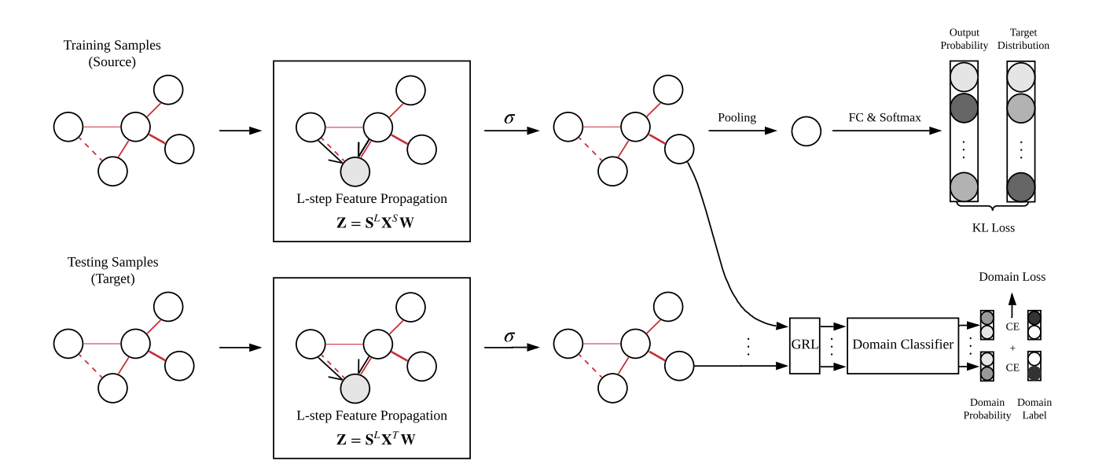
Eeg signal classification: Graphs, adversarial training
Regularized Graph Networks
Adversarial training
Features are learned so that domains can not be classified

Slide 12
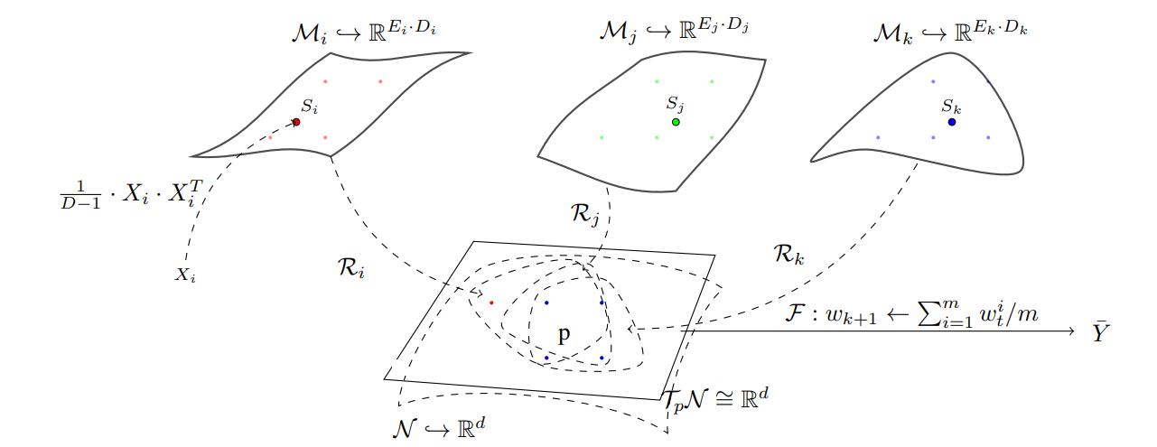
Eeg signal classification: Federated transfer learning
Data privacy
Architecture:
Manifold reduction
Common embedded space
Tangent projection layer
Federated aggregation

Slide 13
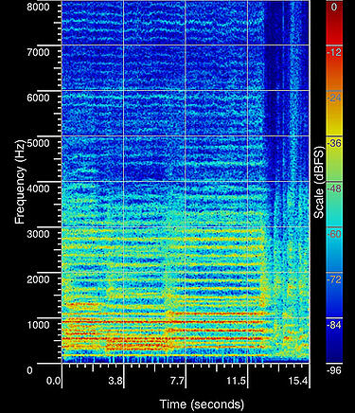
GOALS AND CHALLENGES
Goals
Specifying the exact transfer learning setting
Developing a new architecture or improvement of the previous approaches
Challenges
Representation of EEG
Transfer approach

Slide 14
references
Weiss, Karl, Taghi M. Khoshgoftaar, and DingDing Wang. “A Survey of Transfer Learning.” Journal of Big Data 3, no. 1 (2016). https://doi.org/10.1186/s40537-016-0043-6.
EEG Applications (neurotechedu.com)
Pan, S. J., & Yang, Q. (2010). A Survey on Transfer Learning. IEEE Transactions on Knowledge and Data Engineering, 22(10), 1345–1359. doi:10.1109/tkde.2009.191
Wan, Zitong, Rui Yang, Mengjie Huang, Nianyin Zeng, and Xiaohui Liu. “A Review on Transfer Learning in EEG Signal Analysis.” Neurocomputing 421 (2021): 1–14. https://doi.org/10.1016/j.neucom.2020.09.017.
Wu, Dongrui, Yifan Xu, and Bao-Liang Lu. “Transfer Learning for EEG-Based Brain–Computer Interfaces: A Review of Progress Made since 2016.” IEEE Transactions on Cognitive and Developmental Systems 14, no. 1 (2022): 4–19. https://doi.org/10.1109/tcds.2020.3007453.
Zhang, W., & Wu, D. (2019). Manifold Embedded Knowledge Transfer for Brain-Computer Interfaces. arXiv. https://doi.org/10.48550/arXiv.1910.05878
P. Zanini, M. Congedo, C. Jutten, S. Said, and Y. Berthoumieu, “Transfer learning: a Riemannian geometry framework with applications to brain-computer interfaces,” IEEE Trans. on Biomedical Engineering, vol. 65, no. 5, pp. 1107–1116, 2018.
H. He and D. Wu, “Transfer learning for brain-computer interfaces: A Euclidean space data alignment approach,” IEEE Trans. on Biomedical Engineering, vol. 67, no. 2, pp. 399–410, 2020.
ElMoaqet, H. et al. (2022) “A deep transfer learning framework for Sleep Stage classification with single-channel EEG Signals,” Sensors, 22(22), p. 8826. Available at: https://doi.org/10.3390/s22228826.
Ju, C., Gao, D., Mane, R., Tan, B., Liu, Y., & Guan, C. (2020). Federated Transfer Learning for EEG Signal Classification. arXiv. https://doi.org/10.1109/EMBC44109.2020.9175344
Zhong, P., Wang, D., & Miao, C. (2019). EEG-Based Emotion Recognition Using Regularized Graph Neural Networks. arXiv. https://doi.org/10.48550/arXiv.1907.07835

